Slide 1
THE EMPORIUM
Name : Dhananjay Manik Bhagat
SPPU Exam Seat No : 5614
Division : C

Slide 2
EXISTING SYSTEM
Manual Processes: The existing system may rely on manual processes for managing dairy product inventory, sales, and customer records. This can lead to errors, inefficiencies, and difficulties in data retrieval and analysis.
Lack of Real-time Information: Without an automated system, it becomes challenging to obtain real-time information about stock levels, sales performance, and customer preferences. This hinders decision-making and timely action.
Limited Reporting Capabilities: The existing system may lack robust reporting and analytics features, making it difficult to generate detailed reports on product performance, sales trends, and other key metrics.
Inefficient Inventory Management: Manual tracking of dairy product inventory can be time-consuming and error-prone. It becomes challenging to monitor expiration dates, identify low stock levels, and maintain accurate stock records.
Lack of Integration: The existing system may lack integration with other systems or software used within the dairy farm or processing facility. This can result in data silos, duplication of efforts, and difficulties in maintaining data consistency.

Slide 3
NEED FOR SYSTEM
Fine Listings: Create a user-friendly interface to display various dairy products with images, descriptions, and prices. Categorize products into sections like milk, cheese, yogurt, etc., for easy navigation.
User Accounts: Allow users to create accounts and log in, enabling personalized experiences and order history tracking.
Shopping Cart: Implement a virtual shopping cart where users can add and remove products before proceeding to checkout.
Reviews and Ratings: Allow customers to leave reviews and ratings for products, aiding others in making informed decisions.
Search and Filters: Incorporate a search bar and filters to help users quickly find specific dairy products based on brand, type, price range, etc.

Slide 4
PROPOSED SYSTEM
Order Tracking:- Provide users with real-time updates on their order status, from processing to shipping and delivery.
Product Listings: Create a user-friendly interface to display various dairy products with images, descriptions, and prices. Categorize products into sections like milk, cheese, yogurt, etc., for easy navigation.
Search and Filters:- Incorporate a search bar and filters to help users quickly find specific dairy products based on brand, type, price range, etc.
Secure Payment Gateways:- Integrate trusted payment gateways to ensure secure transactions using credit/debit cards, digital wallets, or other preferred methods.
Discounts:- display ongoing discounts to incentivize purchases.
Shipping Integration: - Partner with reliable shipping services to calculate shipping costs and provide accurate delivery estimates.

Slide 5
Objectives of system
Provide the good user interface to ease of use and it also provide the security to the database.
The System can view the details of any record.
To allow only authorized user to access various function and processed available in the System.
Efficiently manage dairy product inventory, including tracking stock levels, expiration dates, and product details.
Facilitate smooth sales and billing processes, including generating invoices and maintaining customer records.
Provide real-time insights into product availability, sales performance, and customer preferences.
Streamline administrative tasks, such as adding or updating product information and generating reports.
Enhance overall productivity and profitability of the dairy farm or processing facility.
Provide greater speed and reduced time consumption.

Slide 6
SCOPE OF work
Design an intuitive user interface for easy navigation. Ensure responsive design across various devices.-
Implement clear product categorization and search functionality.
Develop user registration and login systems.-
Create a product listing page with images, descriptions, and prices.
Adhere to data protection regulations for user information. Ensure compatibility with popular web browsers.- Optimize for fast loading times and minimal downtime.
Work within the allocated budget and timeline.
Prioritize a seamless and efficient shopping experience. Address user feedback to improve the system over time. Ensure accurate order fulfillment and timely deliveries.
Regularly test the system for security vulnerabilities. Validate payment gateway integrations thoroughly.- Conduct usability testing with a diverse group of users.
Verify order tracking accuracy and reliability.

Slide 7
Module Specification
ADMIN LOGIN MODULE: This module is used to login to the software. The admin has to enter the username and password in order to login to the application.
PRODUCT MODULE: This module used to add product details related to purchase and sales.
CUSTOMER MODULE: This module contains the details of customer who has purchased the products and details related to it in a systematic way.
SELLER MODULE: This module contains the details of all the vendors from whom the product has been purchased by the shopkeeper.
SEARCH MODULE: This module is use to search the accurate product
PURCHASE DETAILS: It deals with purchase like, shopkeeper purchasing the products from vendor.
SALES DETAILS: It deals with sales like, vendor selling the products to customer.
REPORT GENERATION: This module provides a way for viewing the data of sales.

Slide 8
Operating Environment – Hardware and Software
Hardware Requirements :
Processor: Intel i3 10th Generation & above.
Hard Disk: 25 GB Minimum.
RAM: 1 GB Minimum.
Monitor resolution : 1920 x 1080 pixels
Software Requirements :
Operating System: Windows 7 and Higher Version.
Front – End: HTML, CSS, Bootstrap, JavaScript
Back - End: Python Django
Database: SQLite
Editor: PyCharm

Slide 9
Technology used
With the advent of latest technology if we do not update our system then our business result in losses gradually with time.
Here, Python Django is used for logic and view purpose. For designing HTML/CSS/Bootstrap/JavaScript/jQuery is used.
For Database SQLite is used.

Slide 10
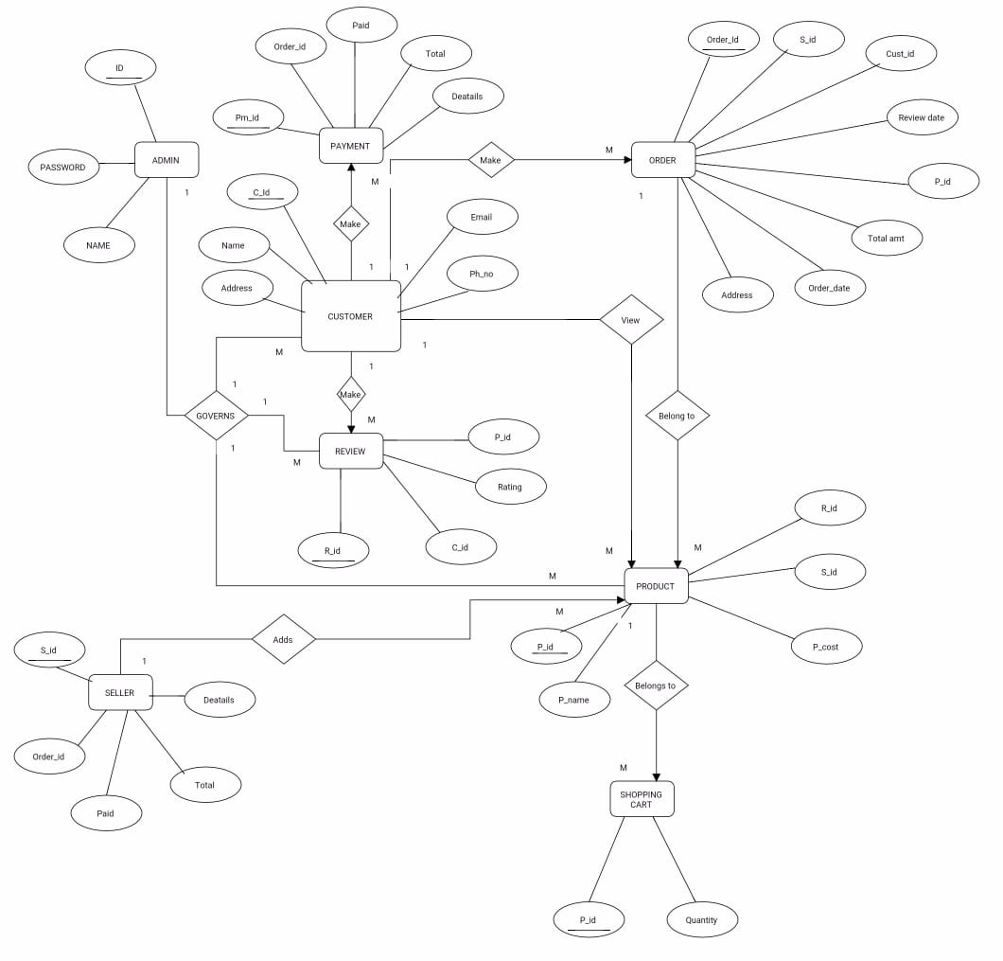
ANALYSIS AND DESIGN
ER Diagram

Slide 11
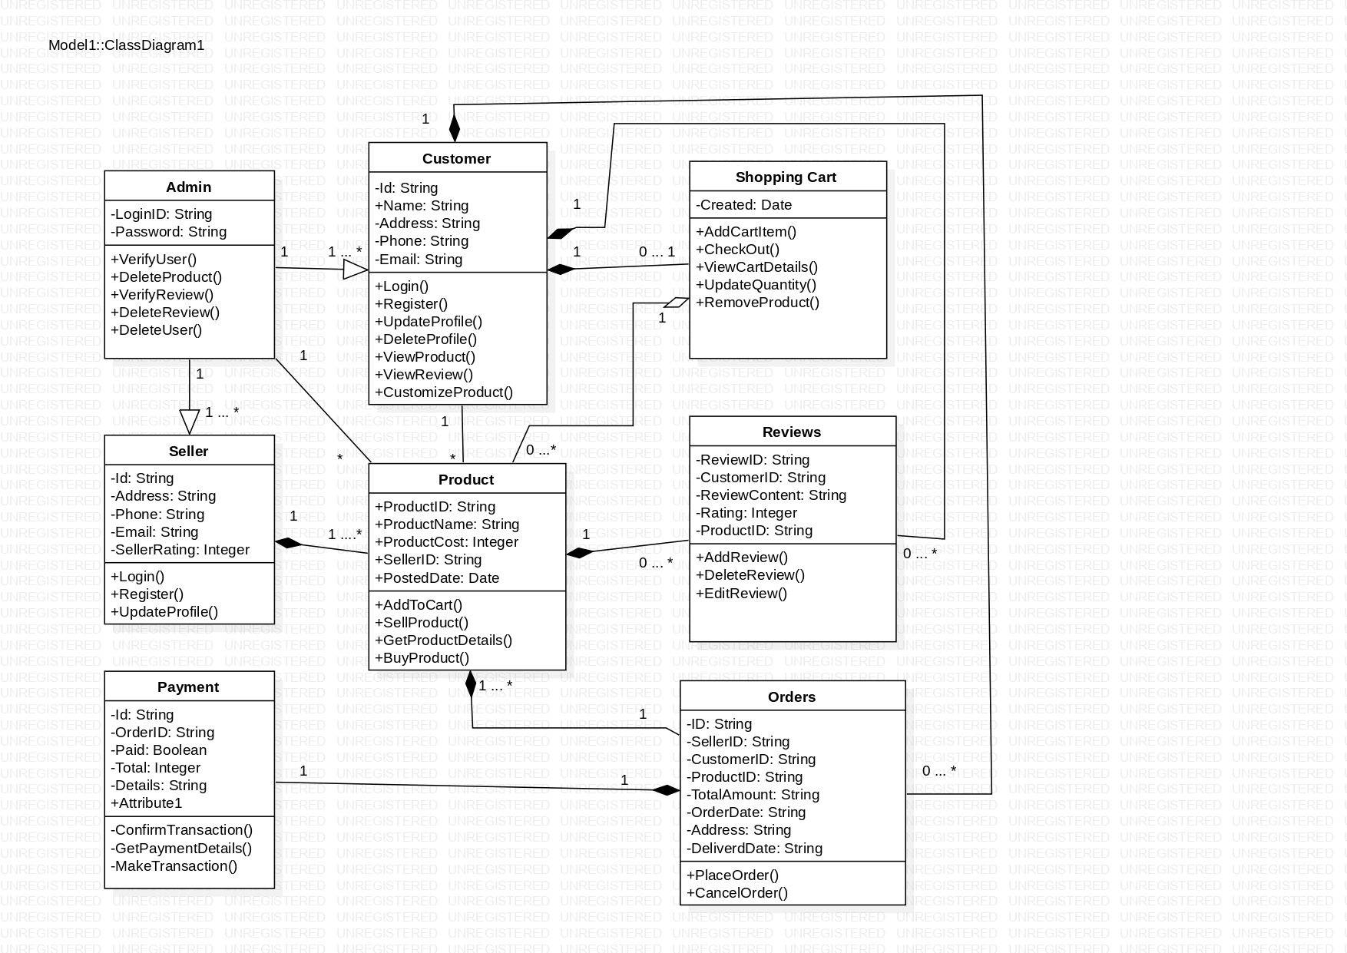
Class Diagram

Slide 12
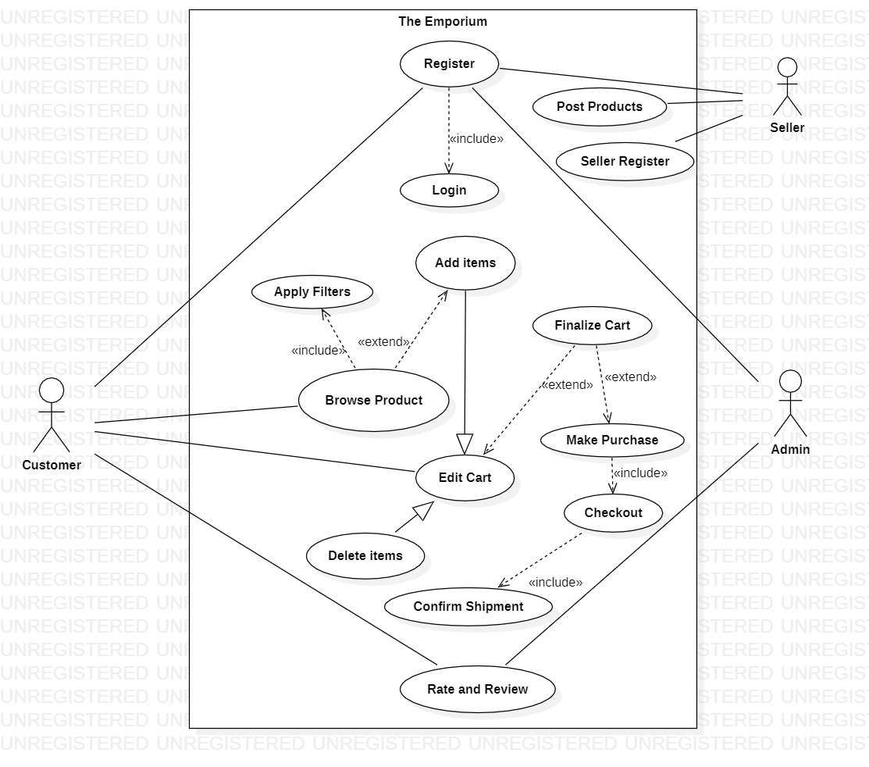
Use Case

Slide 13
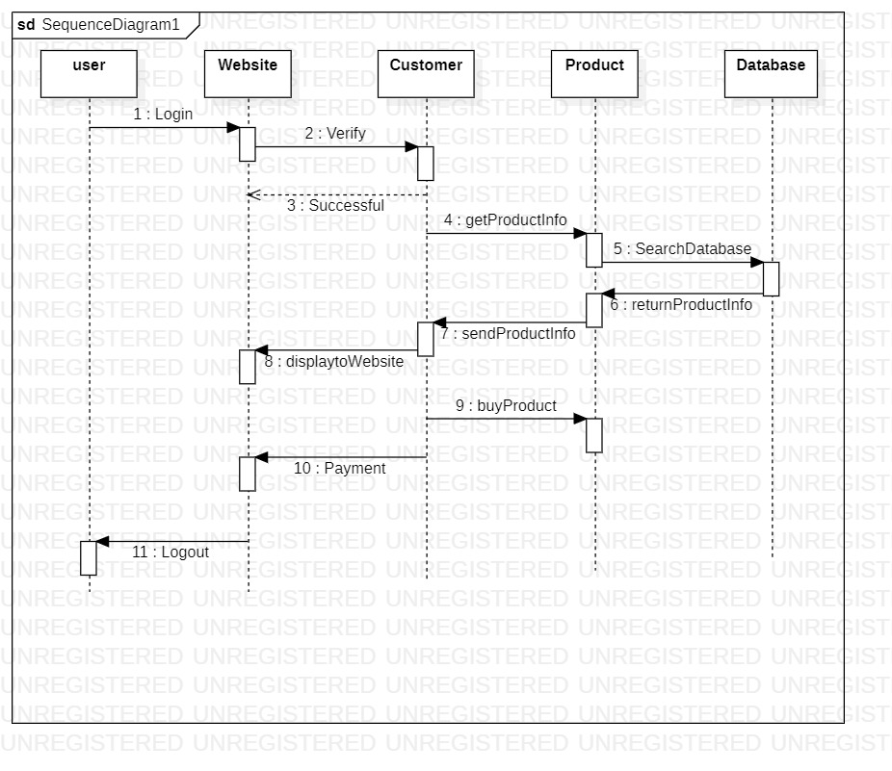
Sequence Diagram

Slide 14
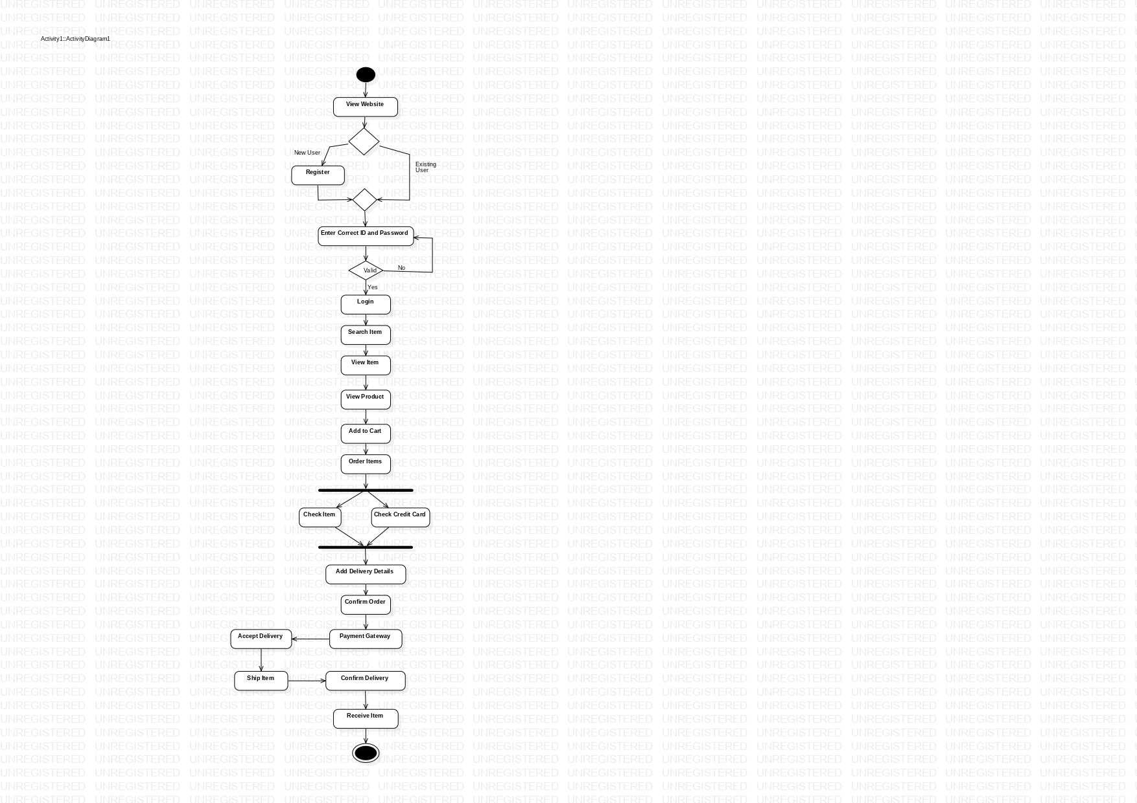
Activity Diagram

Slide 15
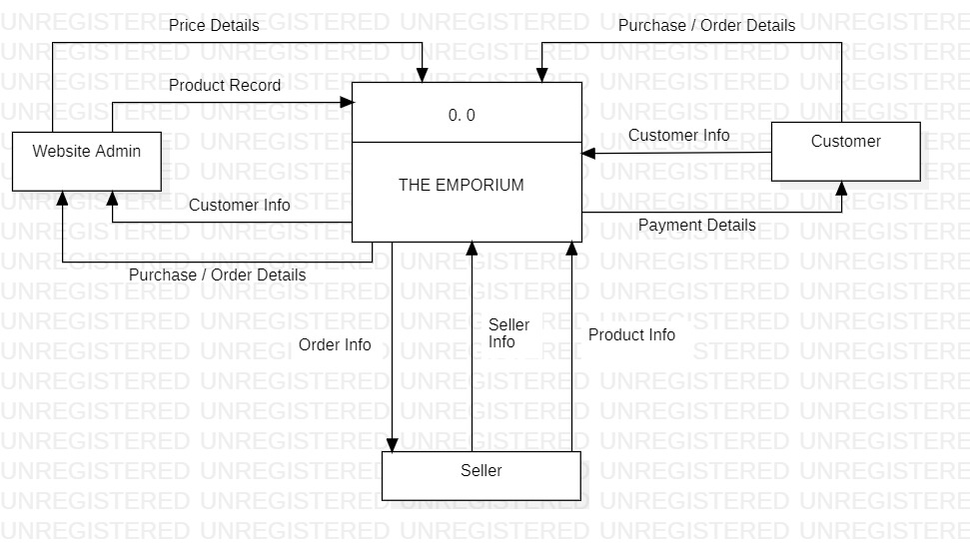
Data Flow Diagram

Slide 16
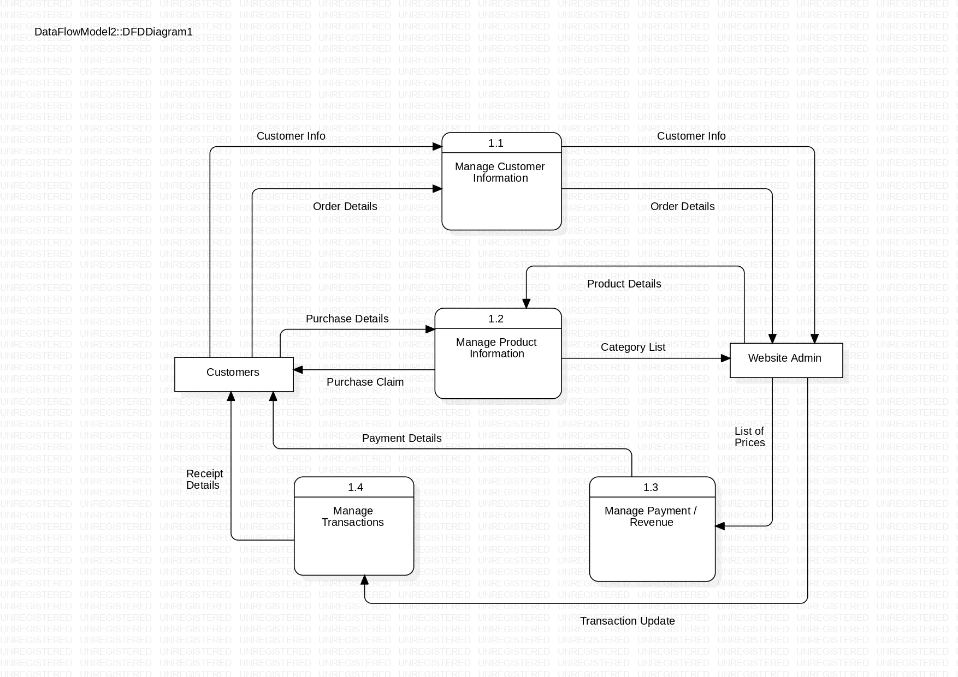
Level 1 :

Slide 17
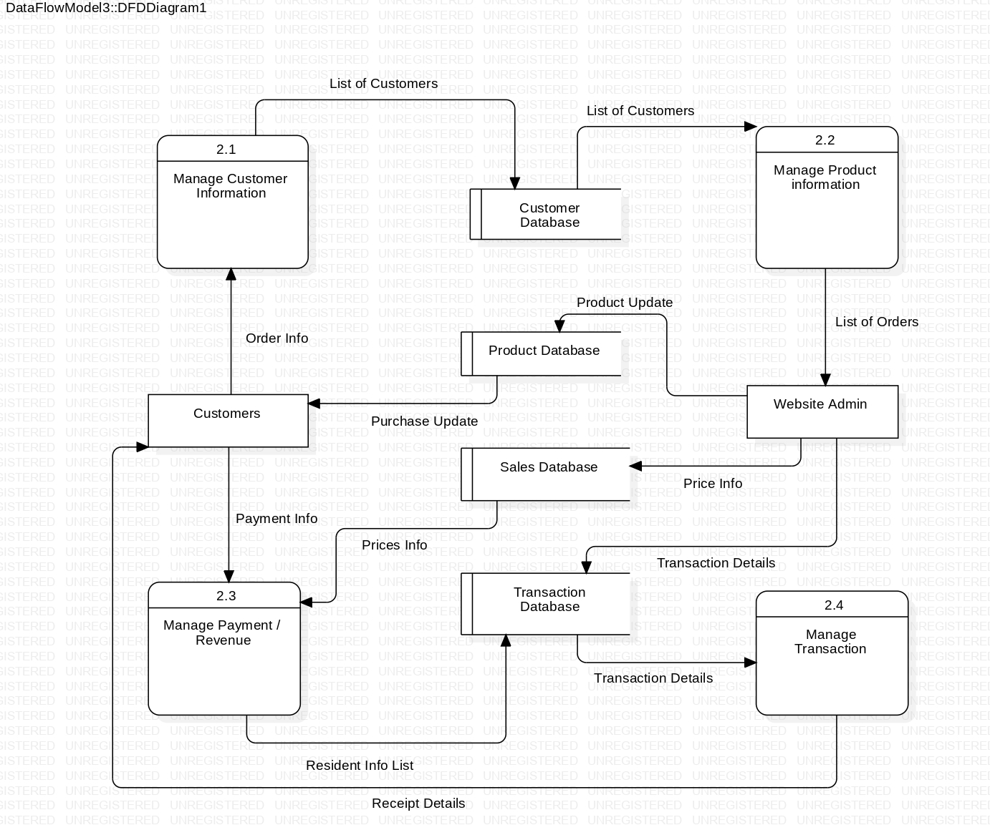
Level 2 :

Slide 18
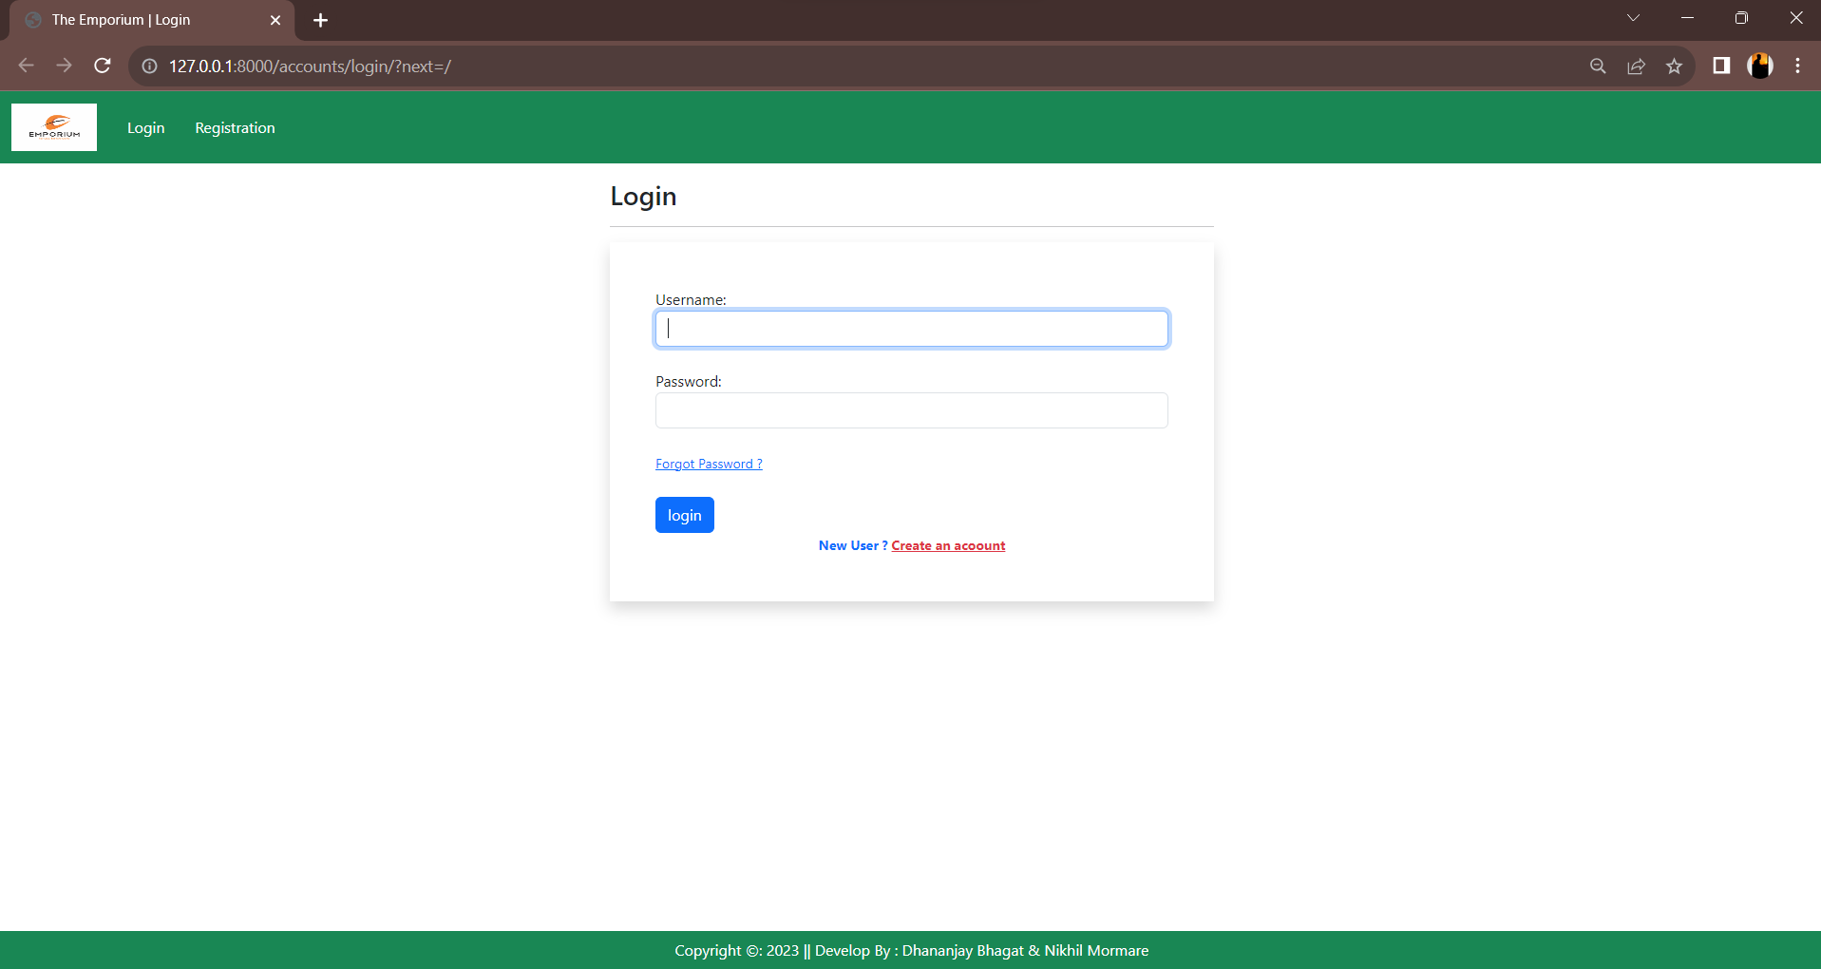
User Interface DESIGN
Admin Login :

Slide 19
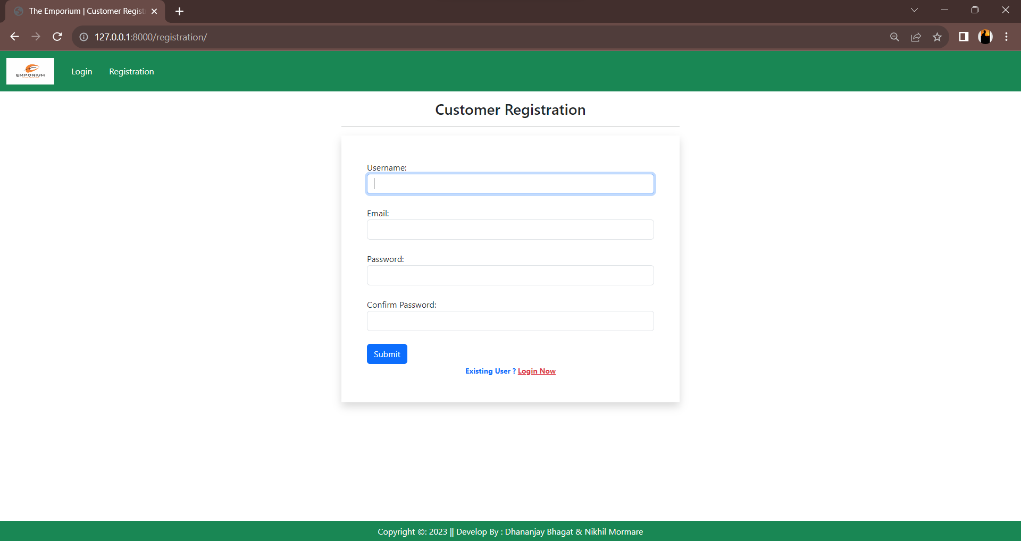
Customer Registration :

Slide 20
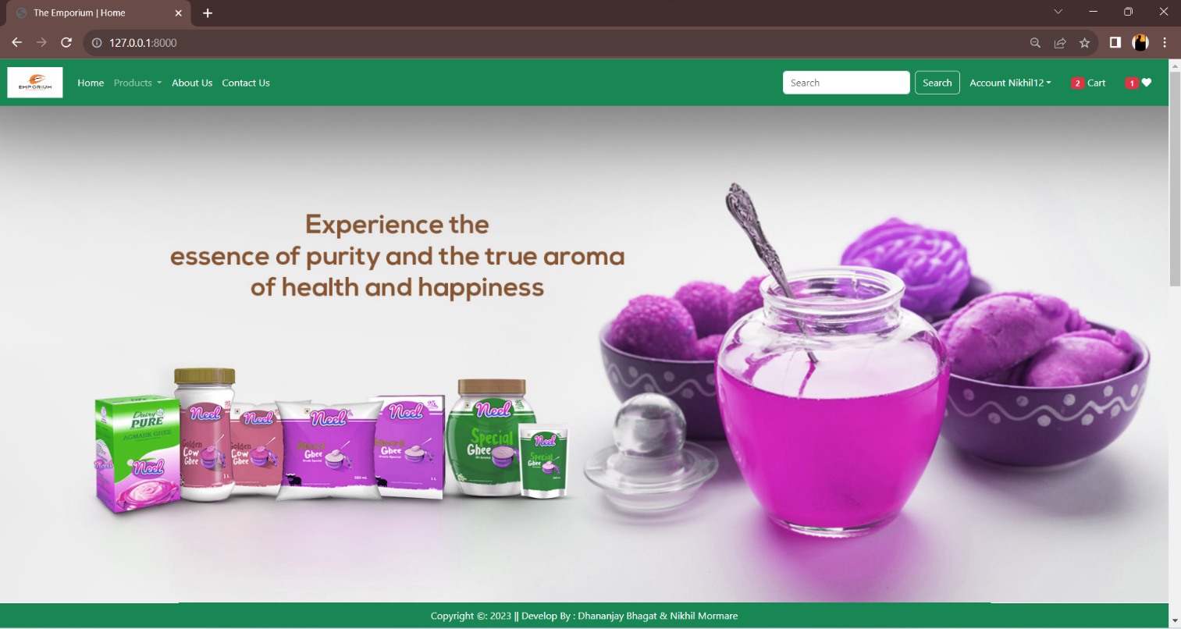
Dashboard :

Slide 21
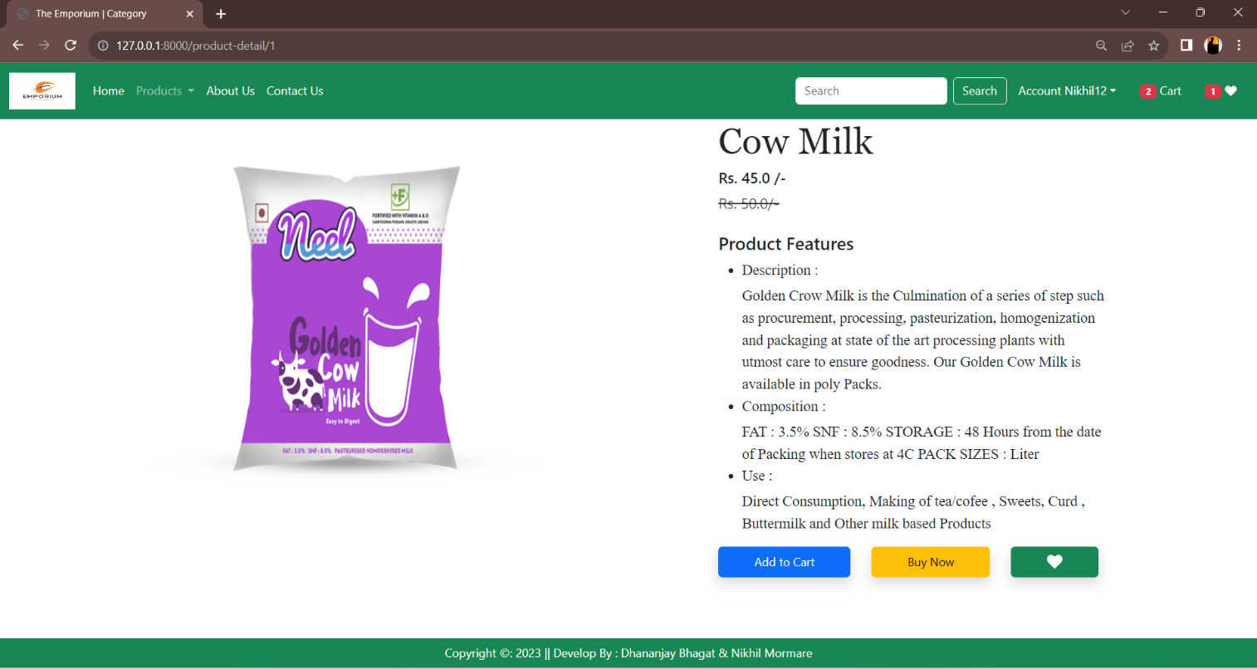
Purchase Product :

Slide 22
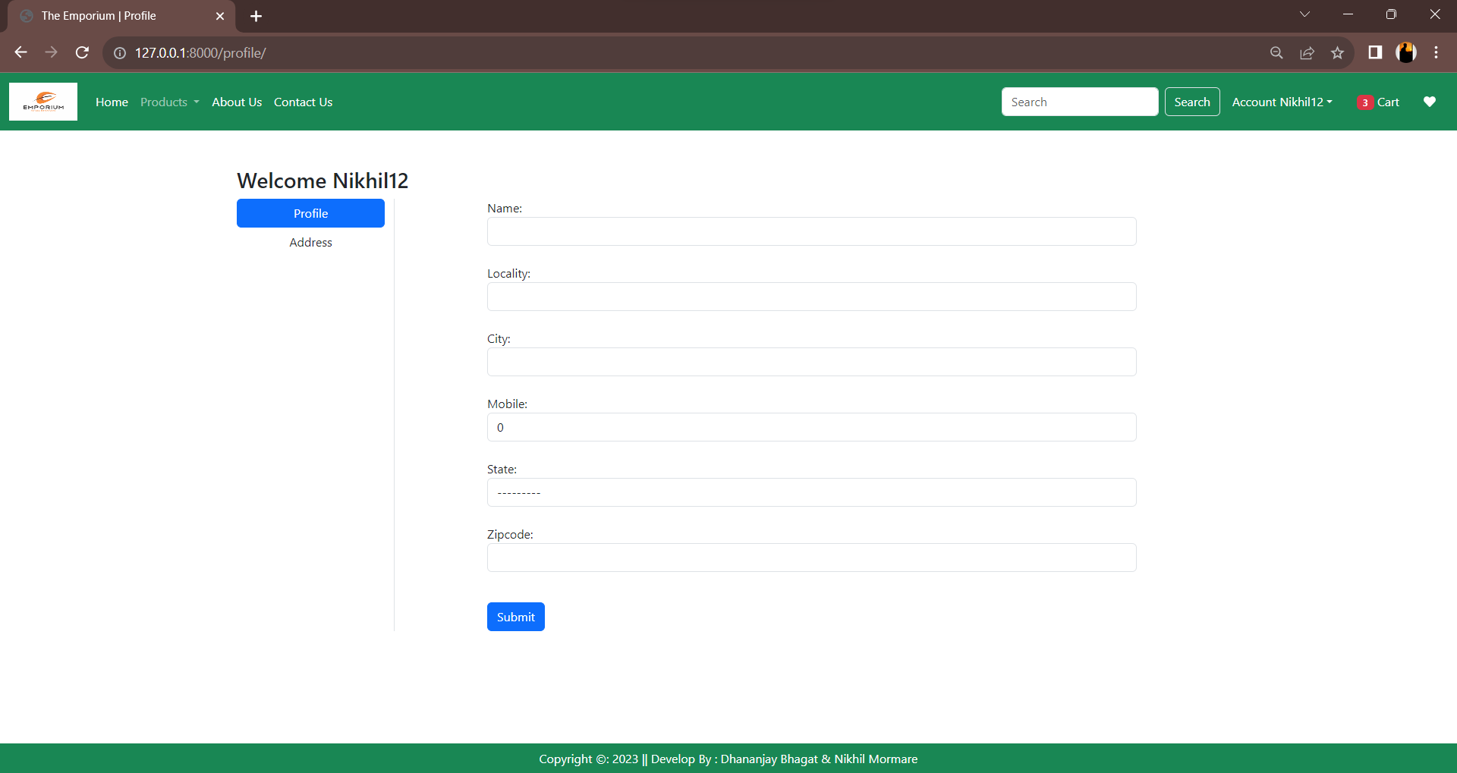
Customer Profile

Slide 23
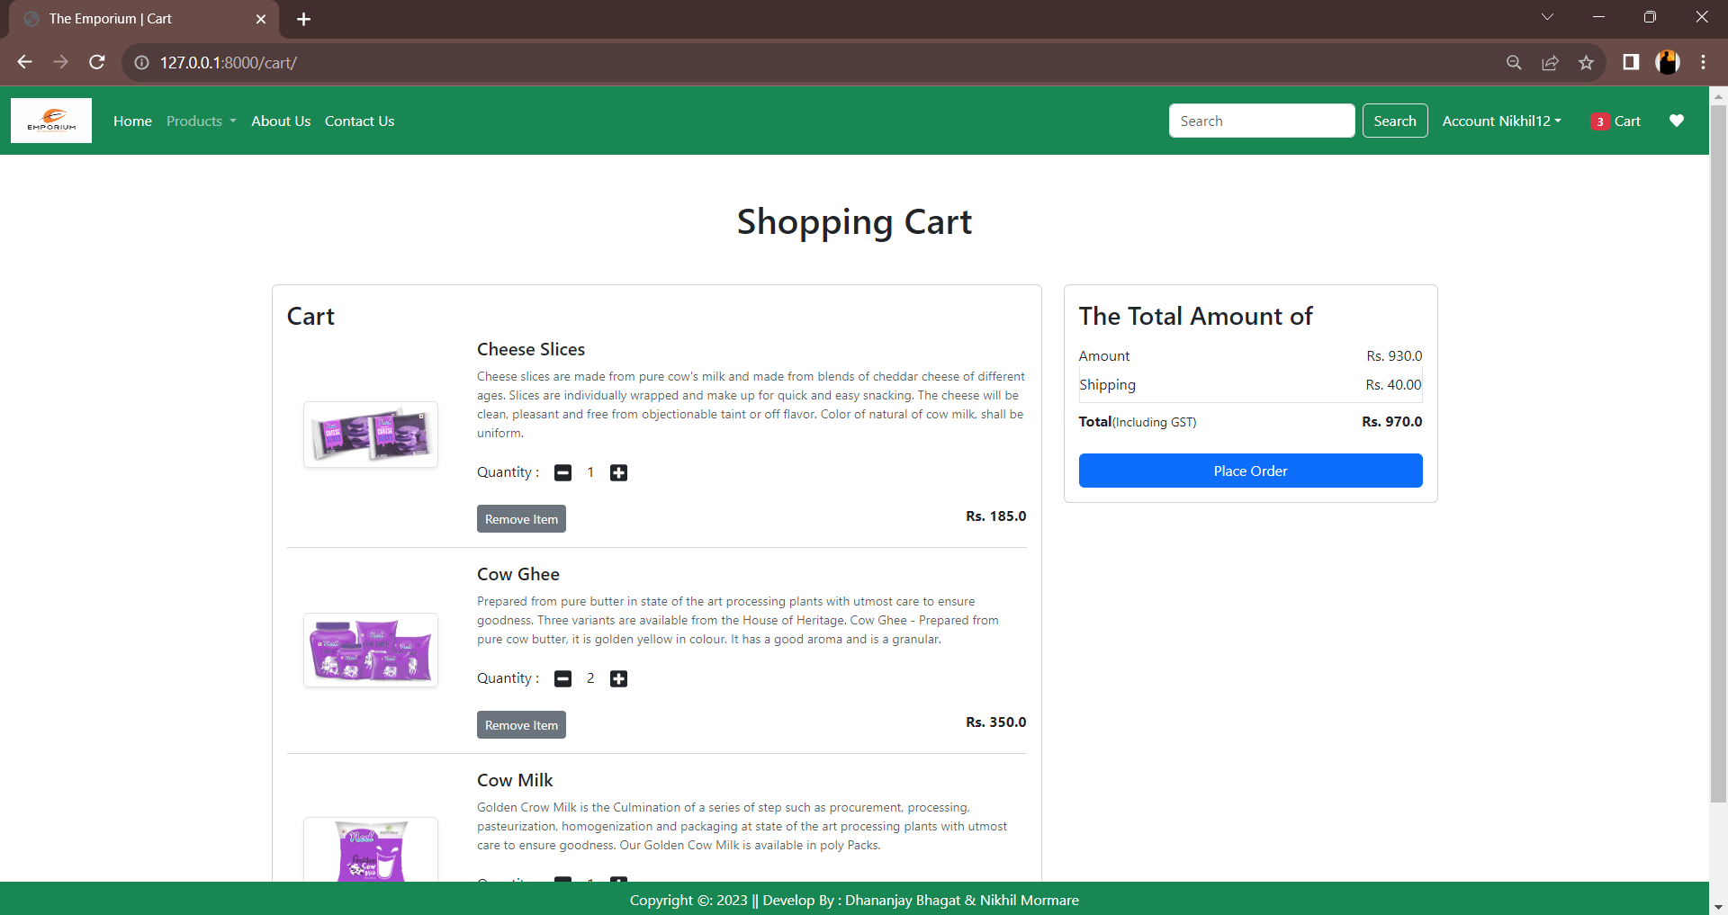
Shopping Cart

Slide 24
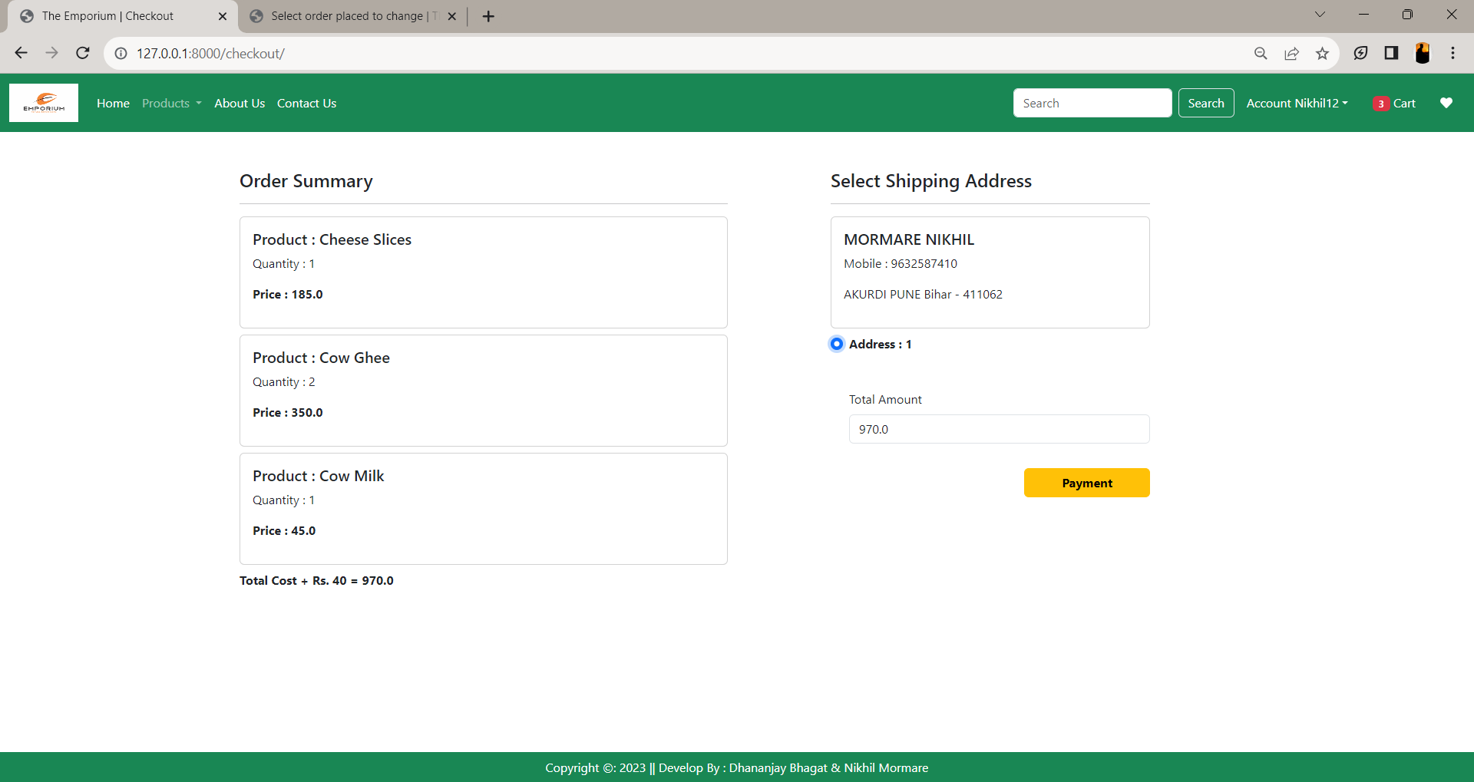
Checkout

Slide 25
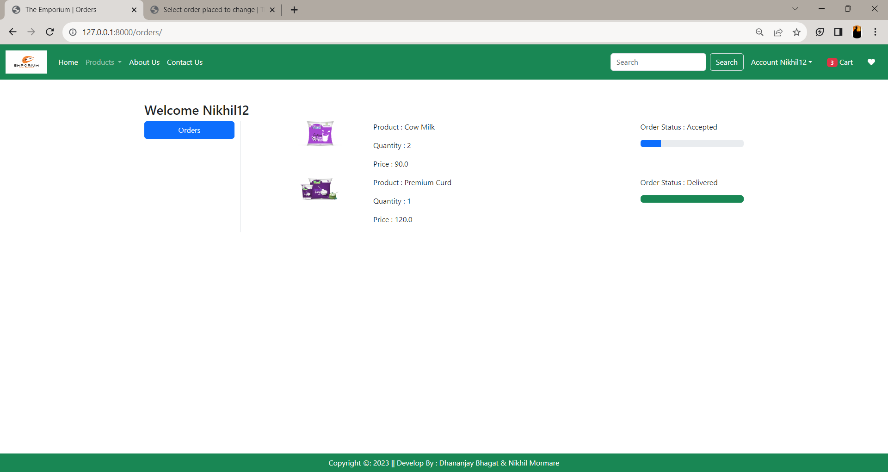
Order

Slide 26
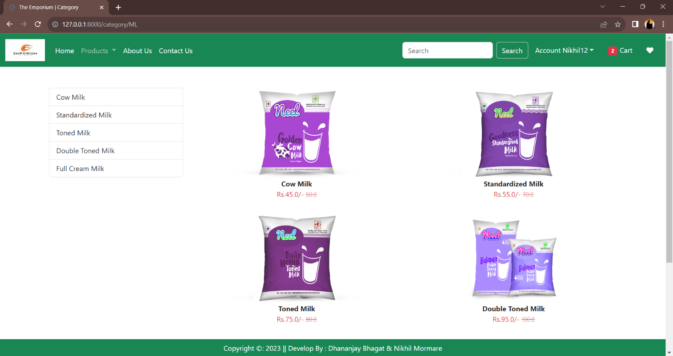
Product Category

Slide 27
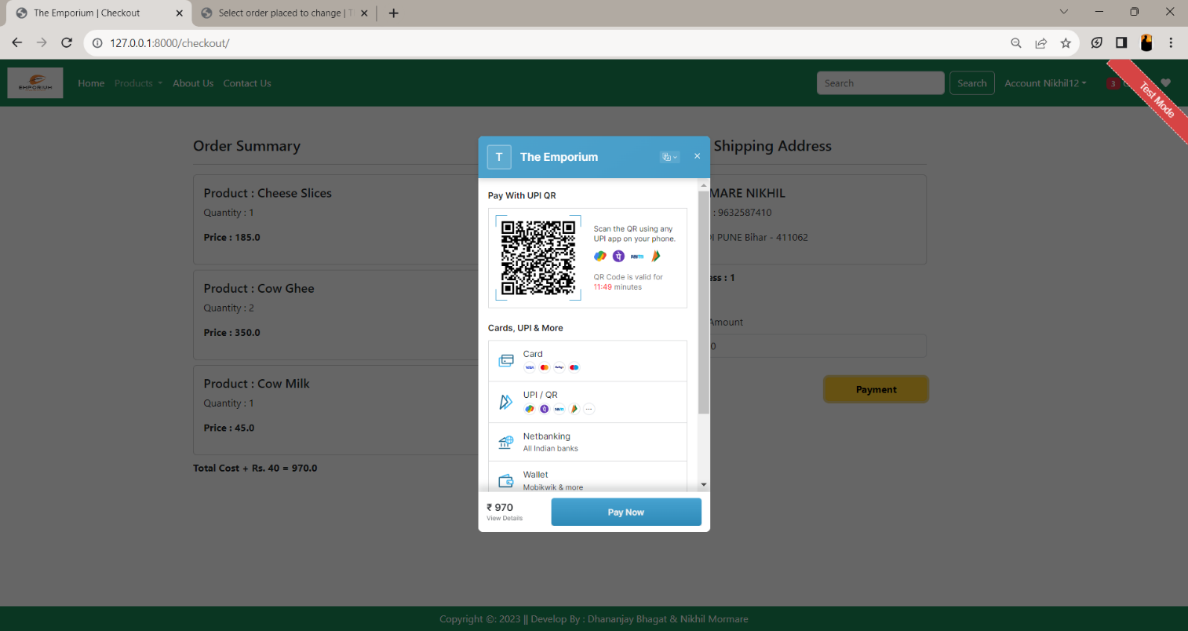
Payment

Slide 28
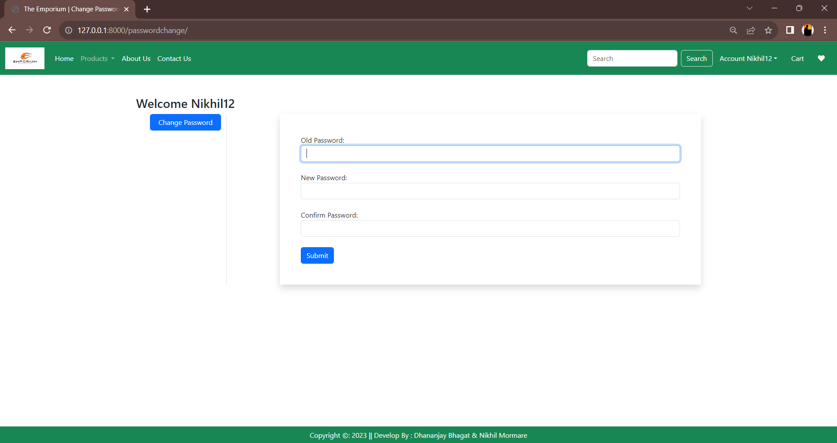
Change Password

Slide 29
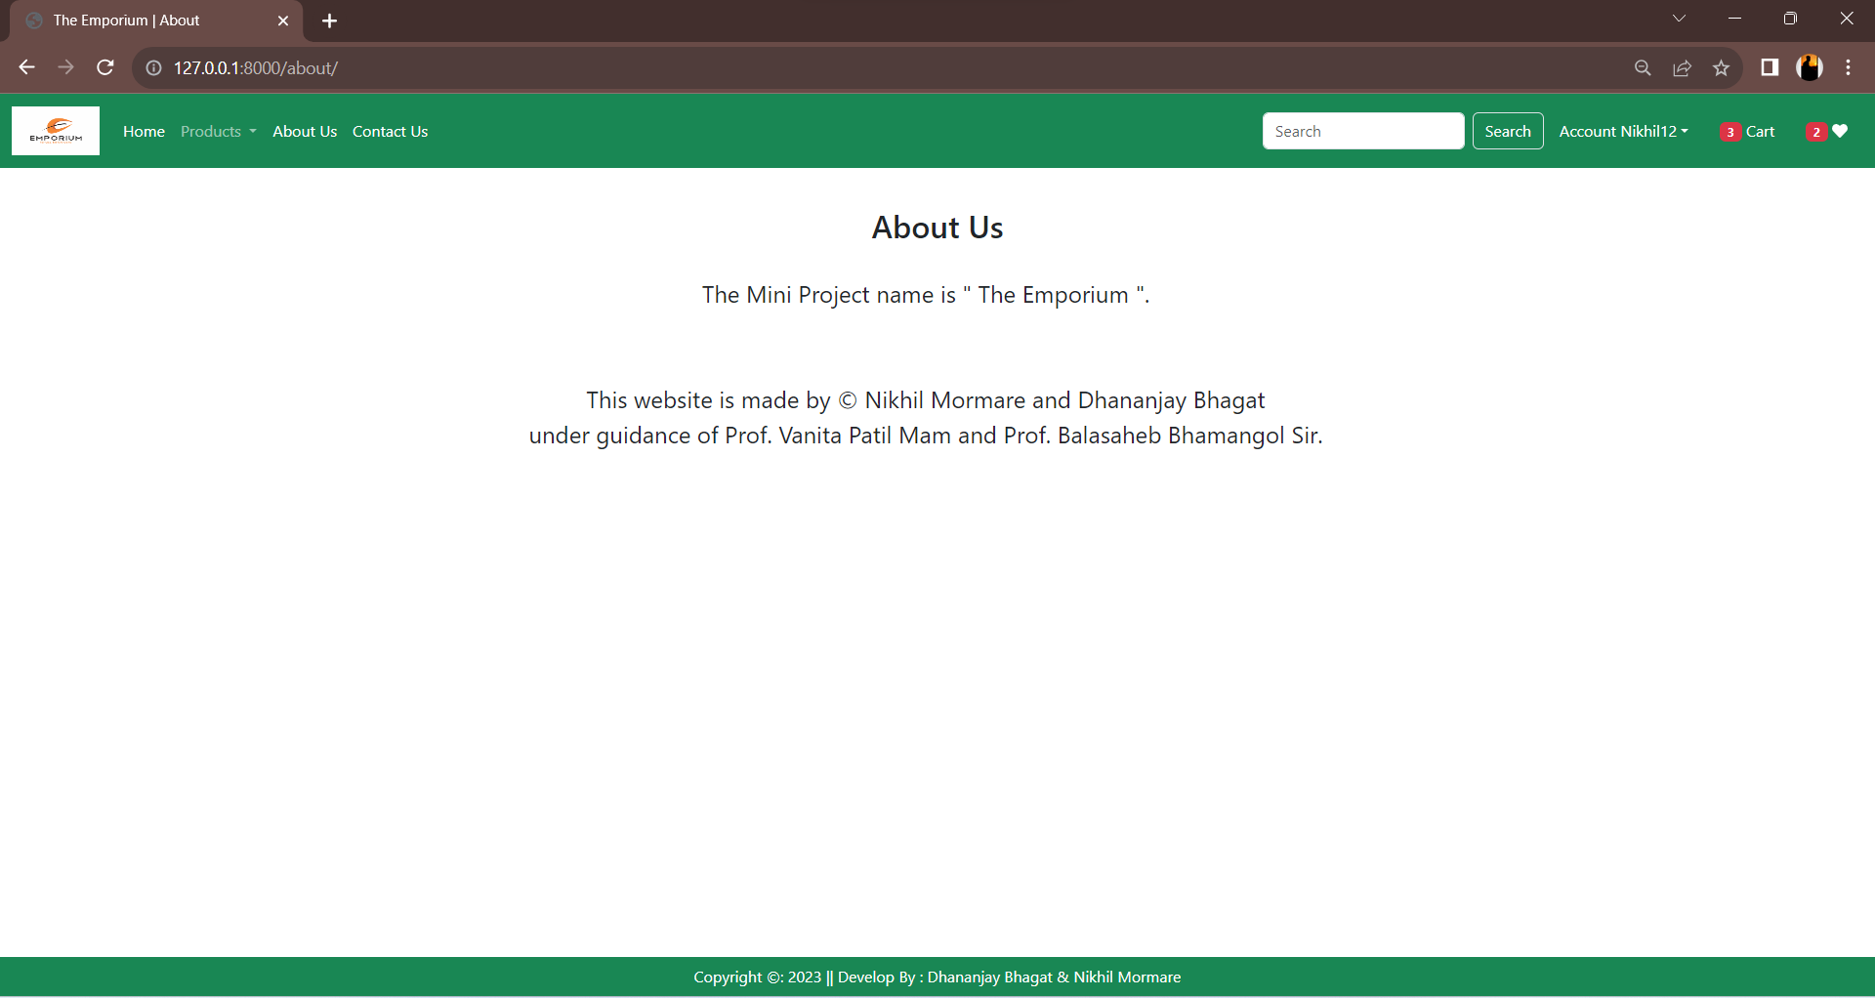
About Us

Slide 30
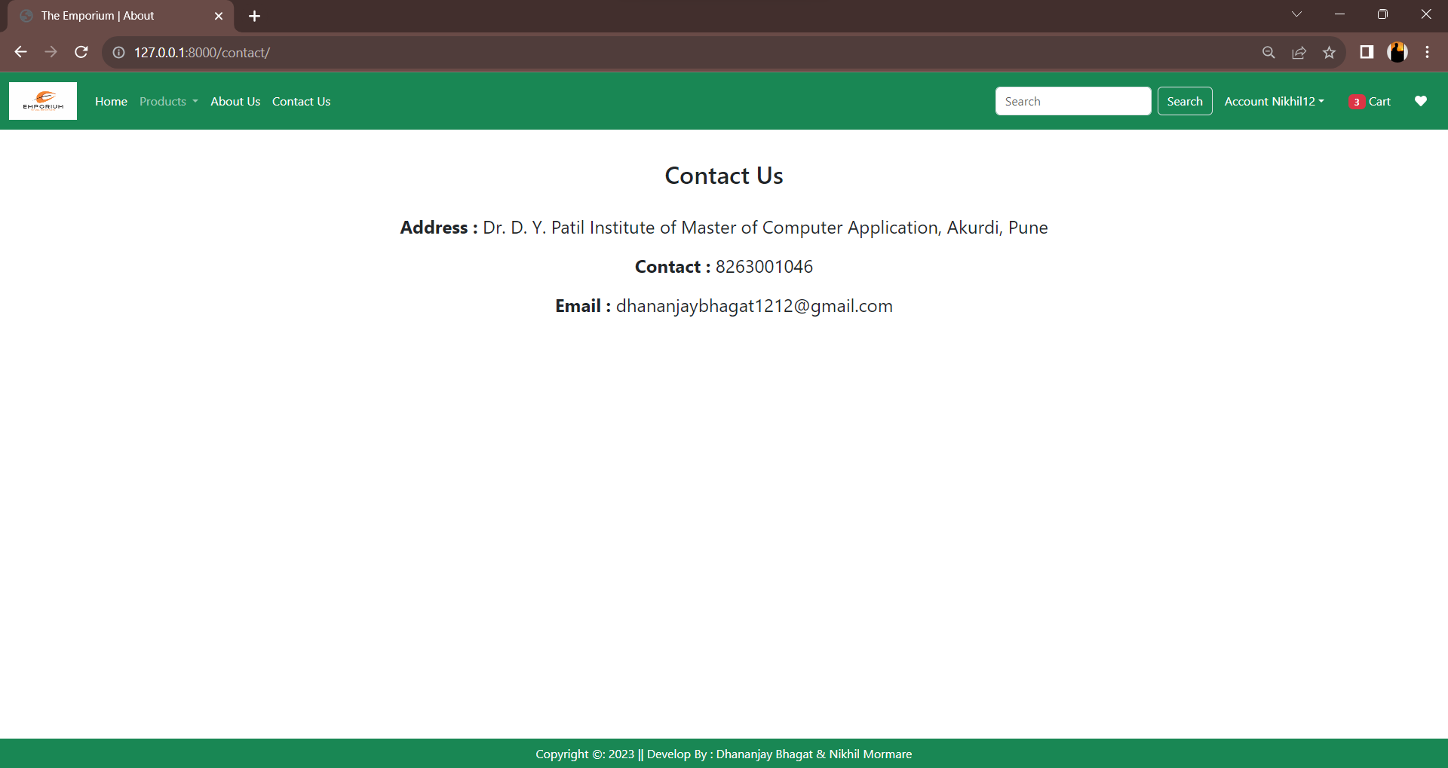
Contact Us

Slide 31
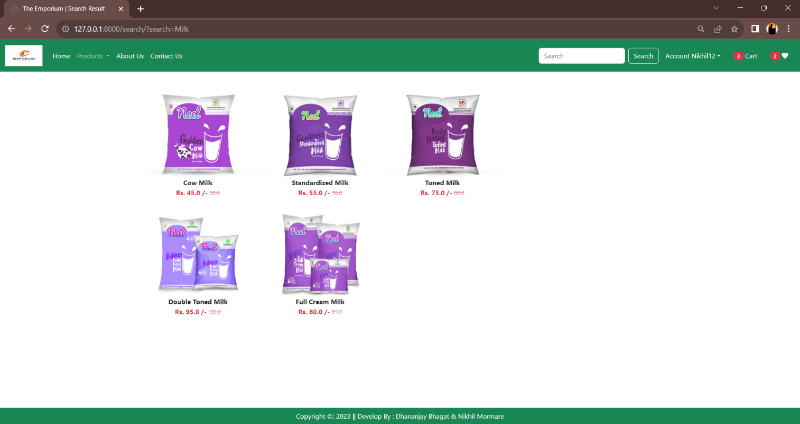
Search Product

Slide 32
Data Dictionary
Admin Table
Sr.No | Field Name | Data Type | Size | Constraints | Description
1 | Id | Integer | 100 | Primary Key | Admin Id
2 | Uname | Varchar | 100 | Not Null | Admin Name
3 | Password | Varchar | 100 | Not Null | Admin Password

Slide 33
Product Detail Table
Customer Table
Sr.No | Field Name | Data Type | Size | Constraints | Description
1 | Prod_id | Varchar | 100 | Primary key | Product Id
2 | Prod_name | Varchar | 45 | Not Null | Product Name
3 | Prod_qty | Integer | 45 | Not Null | Product Quantity
4 | Prod_price | Integer | 45 | Not Null | Product Price
5 | Prod_desc | Varchar | 200 | Not Null | Product Description
6 | Seller_id | Varchar | 100 | Foreign Key | Seller Id
Sr.No | Field Name | Data Type | Size | Constraints | Description
1 | C_id | Varchar | 100 | Primary Key | Customer id
2 | C_name | Varchar | 45 | Not Null | Customer Name
3 | C_contact | Varchar | 45 | Not Null | Customer Contact
4 | C_email | Varchar | 45 | Not Null | Customer Email id
5 | C_address | Varchar | 45 | Not Null | Customer Address
6 | C_Gender | Varchar | 45 | Not Null | Customer Gender

Slide 34
Sr.No | Field Name | Data Type | Size | Constraints | Description
1 | Seller_id | Varchar | 100 | Primary Key | Seller id
2 | Seller_name | Varchar | 45 | Not Null | Seller Name
3 | Contact | Varchar | 45 | Not Null | Seller Contact
4 | Email | Varchar | 45 | Not Null | Seller Email id
5 | Address | Varchar | 45 | Not Null | Seller Address
Seller Table
Payment Table
Sr.No | Field Name | Data Type | Size | Constraints | Description
1 | Payment_id | Varchar | 100 | Primary Key | Purchase id
2 | Order_id | Varchar | 100 | Foreign Key | Seller id
3 | Prod_id | Varchar | 100 | Foreign Key | Product id
4 | Order_qty | Integer | 45 | Not Null | Order Quantity
5 | Prod_price | Integer | 45 | Foreign Key | Product Price

Slide 35
Sr.No | Field Name | Data Type | Size | Constraints | Description
1 | Order_id | Varchar | 100 | Primary Key | Order id
2 | C_id | Varchar | 100 | Foreign Key | Customer id
3 | Prod_id | Varchar | 100 | Foreign Key | Product id
4 | Prod_name | Varchar | 45 | Not Null | Product Name
5 | Quantity | Integer | 45 | Not Null | Quantity
6 | Prod_price | Integer | 100 | Not Null | Product Price
7 | Total_amt | Integer | 100 | Not Null | Total Amount
8 | Order date | Timestamp | 20 | Not Null | Current Timestamp
Order Table
Review table
Sr.No | Field Name | Data Type | Size | Constraints | Description
1 | R_id | Varchar | 100 | Primary Key | Review id
2 | C_id | Varchar | 100 | Foreign Key | Customer id
3 | Prod_id | Varchar | 100 | Foreign key | Product id
4 | Rating | Varchar | 200 | Not Null | Rating

Slide 36
Cart
Sr.No | Field Name | Data Type | Size | Constraints | Description
1 | C_id | Varchar | 100 | Foreign Key | Customer id
2 | Prod_id | Varchar | 100 | Foreign Key | Product id
3 | Quantity | Varchar | 45 | Not Null | Quantity

Slide 37
Drawbacks And Limitations
Learning Curve: The system may have a learning curve for users who are not familiar with the software or technology. It may require training or assistance to effectively navigate and utilize all the features and functionalities.
Initial Setup and Maintenance: Setting up the system and maintaining the infrastructure, such as the database and server, may require technical expertise. This can pose a challenge for small-scale dairy farms or facilities with limited resources.
Data Security: While the system may have user authentication and access control features, data security can still be a concern. Without proper encryption or safeguards, sensitive information stored in the system, such as customer data or financial records, may be at risk of unauthorized access or data breaches.

Slide 38
Proposed Enhancement
Current system is developed according to current requirements which can be added later. In this, system can be merged with another system to make bigger system invoking many functions on it.
No project is ever complete in itself; there are always minor or major changes in the project according to user requirements.
This project could be enhanced in the sense that it can overcome its limitations in the future as sample scope for enhancement.
Latest electronic and software technologies can help to bring in more enhancement which would help to make the system more user friendly and also help to maintain adequate security.
To make the application as online so that it would be helpful to everyone.

Slide 39


